Slide 1
Welcome

Slide 2
MAKING THE MOST OF THIS COURSE

Slide 3
no required programming experience

Slide 4
no required platform

Slide 5
no required background

Slide 6
WHAT IS PROGRAMMING?

Slide 7
“A computer program is a
set of instructions…”

Slide 8

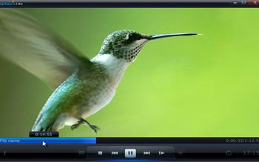


Slide 9
turn right
drive one mile
turn left on bank
take the second right
fourth house on the left

Slide 10
turn right
drive one mile

Slide 11


Slide 12
200 + 300 = 500

Slide 13
STATEMENTS
BASIC LET Balance = 500
AppleScript set balance to 500
Java balance = 500;
COBOL MOVE 500 TO BALANCE

Slide 14
WHAT IS A PROGRAMMING LANGUAGE?

Slide 15
Is the ability to take the idea into your head, break it a part into each individually pieces and now write those pieces into your programing language using at a time . Writing Your statement in a right order with right syntax

Slide 16
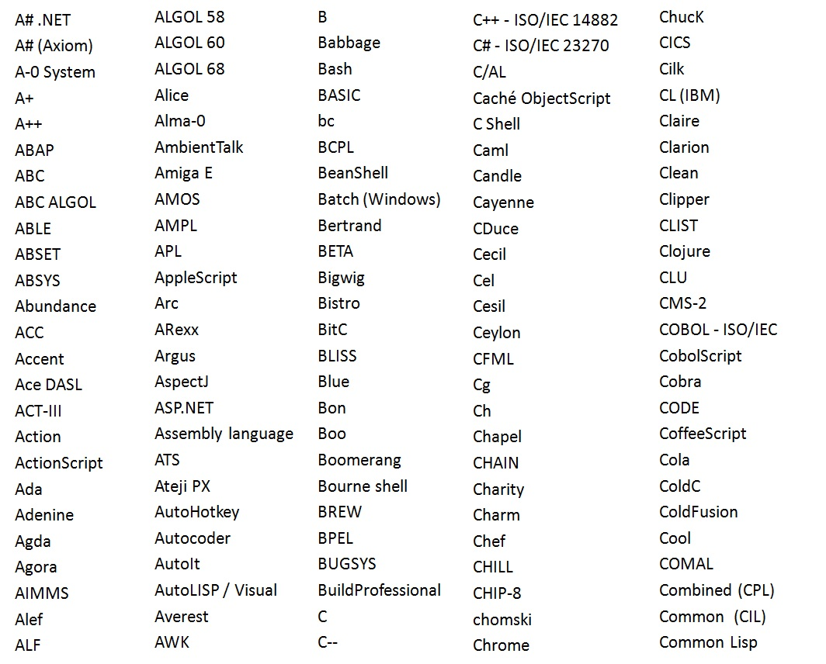

Slide 17
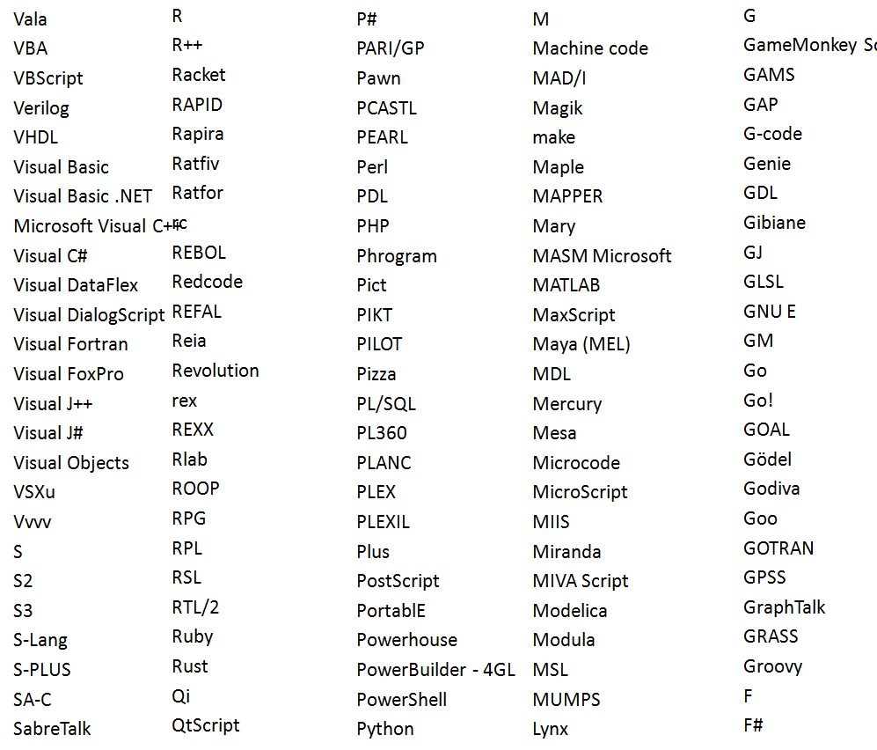
C
C++
C#
Java
JavaScript
Perl
PHP
Python
Objective-C
Ruby
Visual basic

Slide 18
6A
10
04
0C
55
48
EC
00
14
4C
48
00
00
00
00
00
14
00
89
48
00
48
8D
89
00
01
E9
00
01
E9
8D
65
00
00
00
00
FA
83
00
89
3D
4D
89
00
0A
1D
6C
00
E5
C2
08
89
48
00
46
E4
FF
12
65
81
G4
2G
6B
1B
00
5G
F2
F2
D3
E8
88
89
00
0B
0A
1B
1A
2B
2A
3C
D3
D4
5F
FF
DD
AA
B1
11
BB
CC
C8
C9
10
20
2F
F0
6A
10
04
0C
55
48
EC
00
14
4C
48
00
00
00
00
00
14
00
89
48
00
48
8D
89
00
01
E9
00
01
E9
8D
65
00
00
00
00
FA
83
00
89
3D
4D
89
00
0A
1D
6C
00
E5
C2
08
89
48
00
46
E4
FF
12
65
81
G4
2G
6B
1B
00
5G
F2
F2
D3
E8
88
89
00
0B
0A
1B
1A
2B
2A
3C
D3
D4
5F
FF
DD
AA
B1
11
BB
CC
C8
C9
10
20
2F
F0
F3
D5
D0
89
00
A2
A5
B2
B5
00
89
3D
4D
89
00
0A
1D
6C
00
E5
C2
08
89
48
00
46
E4
FF
5D
D0
89
E4
B0
A1
F3
3D
3B
BB
50
F0
D0
A1
D1
D3
D4
5F
FF
DD
AA
B1
11
BB
CC
0A
1D
6C
00
E5
C2
08
89
48
00
46
E4
FF
5D
D0
89
E4
B0
A1
F3
3D
3B
BB
50
F0
D0
A1
D1
D3
D4
5F
FF
DD
AA
B1
11
BB
CC

Slide 19
JavaScript, ActionScript
High-Level Languages
Ruby, Python, PHP
Java, C#, VB.NET
Objective-C
C++
C
Low-Level Languages
Assembly Language
Machine code
CPU

Slide 20
WRITING SOURCE CODE

Slide 21
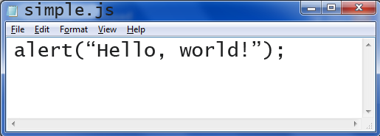
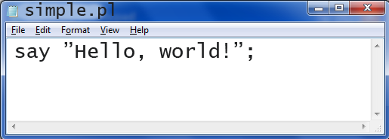
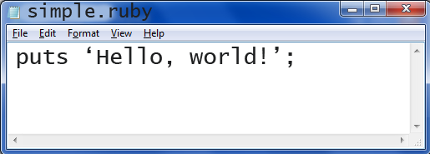


Slide 22
print(“Hello, World!”)
ALGOL 68
ALGOL 68 / Python 3 /
Python 3
Lua

Slide 23
ALGOL 60 BEGIN DISPLAY (“Hello, Wolrd!”); END.

Slide 24
C #include <studio.h> int main(void) { printf(“Hello, world\n”); return 0; }

Slide 25
C# using system; class Example { static void Main(string[] args) { Console.WriteLine(“Hello world!”); } }

Slide 26
Java public class HelloWorld{ public static void main(string[] args){ System.out.println(“Hello, World!”); } }

Slide 27
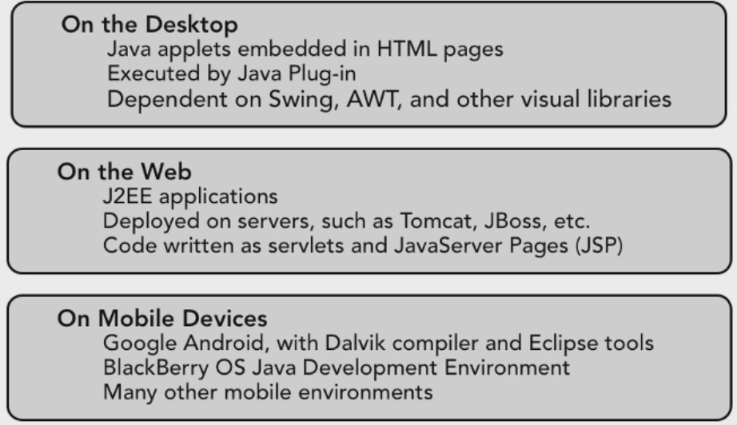
Where Java is Used

Slide 28
Where Java is Not Used
JavaScript
Not Native Mobile Apps for Iphone, Windows

Slide 29
Types Of Java Application
Games
Mobile Apps
Cloud Computing(is the internet-based storage for files, applications, and infrastructure)
Databases
Websites

Slide 30
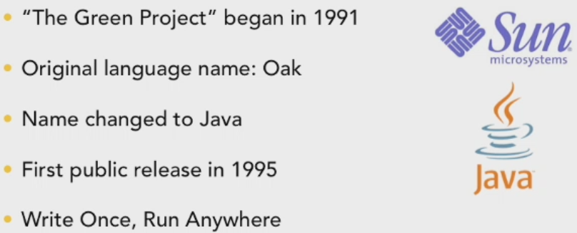
History Of Java

Slide 31
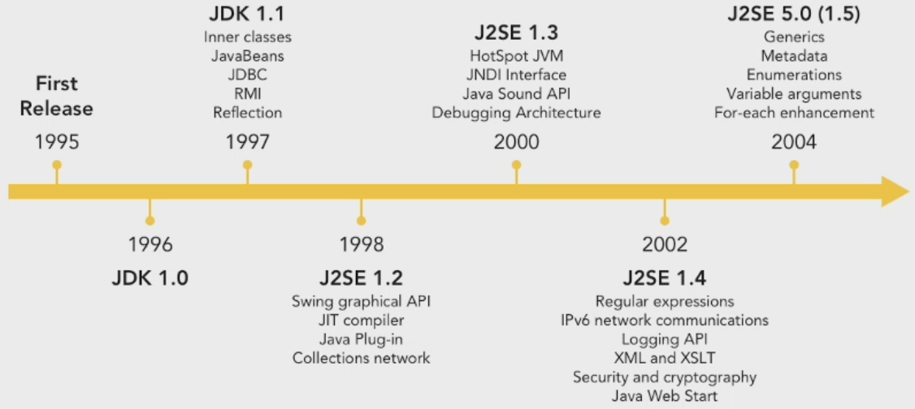
History Of Java

Slide 32
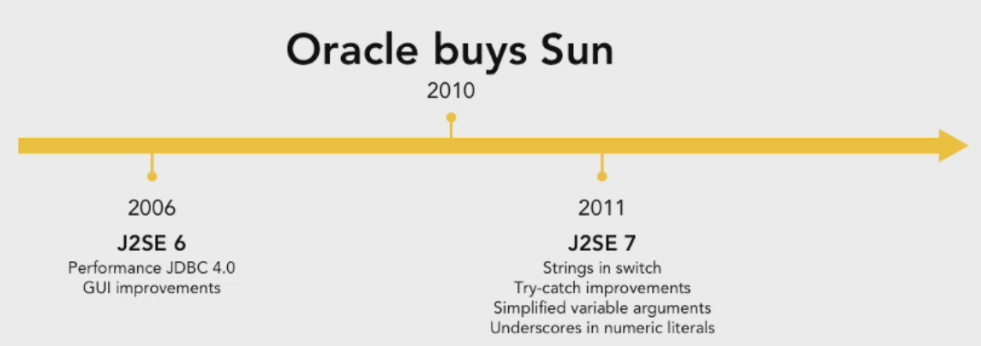
History Of Java

Slide 33
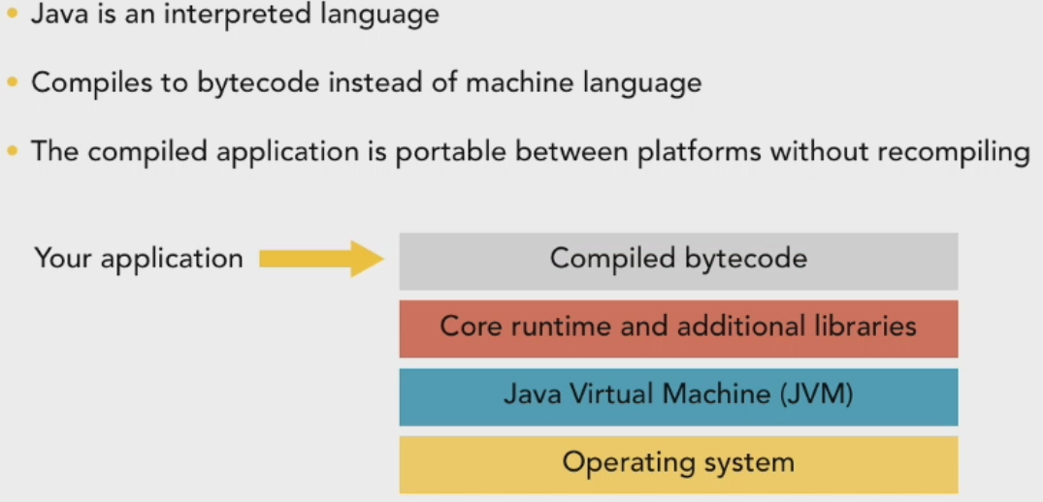
Runtime Architecture

Slide 34
First Java Program-Example
/*This is a simple java program*/
class Example
{
public static void main (String ar[])
{
System.out.println (“This is a simple Java program”);
}
}

Slide 35
class This marks the starting of java code. It is a key word of java.
public This specify the main ( ) is accessible from outside of the class
static This specify that to execute main ( ) even no class objects have been created
void This specify that method does not return value
main JVM is responsible to execute main method
String ar[] String Array data type, species that main takes some arguments when executed (Note that is no argument specified then Sting array takes null as the argument, hence no error occurs).
System This is name of the class that contains the object
out It is static data member of System class
println This is the method which prints the output in the dos command.

Slide 36
Keywords
The following keywords are reserved in Java, so you must not use them as class names in your programs
abstract | case | continue | extends | goto | int | package | short | synchronized | try
assert | catch | default | final | if | interface | private | static | this | void
boolean | char | do | finally | implements | long | protected | strictfp | throw | volatile
Break | class | double | float | import | native | public | super | throws | while
Byte | const | else | for | instanceof | new | return | switch | transient

